Slide 1
Object Oriented Programming in Java Properties, Beans, and Bindings – Part 1

Slide 2
Lesson Structure and Goals
Topics
Properties
Java FX components as Java Beans
Bindings Beans
After completing this lesson, you will be able to
Build JavaFX applications that use binding among JavaFX component properties

Slide 3
Java FX Properties
Properties: a collection of classes (similar to wrapper classes) that create property objects.
A property can be
hooked up to an event-listener that responds when the property-value changes
bound to another property as an ‘observable’ to respond when it changes
JavaFX provides four types of property classes for each of its basic data types. For example, for String, it provides:
ReadOnlyStringProperty: An abstract class that represents a read-only property.
StringProperty: Another abstract class that represents a read-write property. This class extends ReadOnlyStringProperty.
SimpleStringProperty: This is the class that you instantiate to create a read/write string property.
ReadOnlyStringWrapper: This is the class you instantiate to create a read-only string property.
Similarly for
integer: ReadOnlyIntegerProperty, IntegerProperty, SimpleIntegerProperty, ReadOnlyIntegerWrapper
double: ReadOnlyDoubleProperty, DoubleProperty, SimpleDoubleProperty, ReadOnlyDoubleWrapper
… and so on

Slide 4
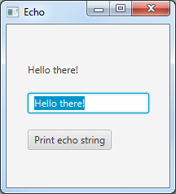
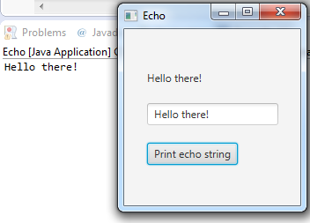
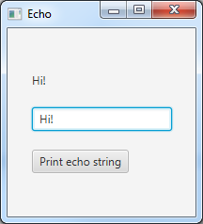
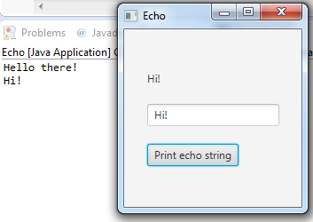
JavaFX Beans
All JavaFX components are Java beans
Java Beans
Classes whose member variables are properties
Hooked to event listeners
Can be bound to each other
These properties can be accessed through methods, usually getter/setter methods
Example: Echo program
Has three key ‘things’: soundTextField, echoLabel, echoString
echoString is initialized as “Hello there!” in the code
soundTextField and echoLabel start off with displaying the value in echoString
Pressing Print button prints echoString on Console
Change in soundTextField should change the other two
We need to ‘bind’ them together
echoLabel
soundTextField
printButton
soundTextField
echoString
echoLabel

Slide 5
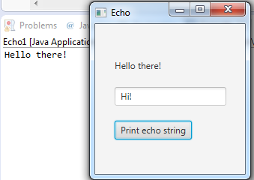
Echo1
public class Echo1 extends Application{
public static void main(String[] args) {
launch(args);
}
@Override
public void start(Stage primaryStage) throws Exception {
Scene scene = new Scene(setScreen(), 200, 200);
primaryStage.setScene(scene);
primaryStage.setTitle("Echo");
primaryStage.show();
}
GridPane setScreen() {
GridPane grid = new GridPane();
String echoString = "Hello there!";
Label echoLabel = new Label(echoString);
TextField soundTextField = new TextField();
soundTextField.setText(echoString);
Button printButton = new Button("Print echo string");
printButton.setOnAction(new EventHandler<ActionEvent> () {
@Override
public void handle(ActionEvent event) {
System.out.println(echoString);
}
});
//set components in the grid
grid.add(echoLabel, 0, 0);
grid.add(soundTextField, 0, 1);
grid.add(printButton, 0, 2);
grid.setAlignment(Pos.CENTER);
grid.setVgap(20);
return grid;
}}

Slide 6
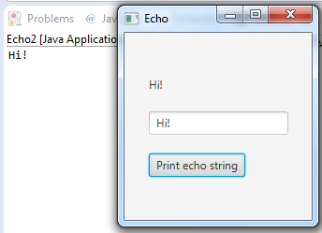
Echo2
GridPane setScreen() {
GridPane grid = new GridPane();
StringProperty echoString = new SimpleStringProperty("Hello there!"); //now it can be bound
Label echoLabel = new Label(echoString.getValue()); //echoLabel shows value of echoString
TextField soundTextField = new TextField();
soundTextField.setText(echoString.getValue()); //soundTextfield also shows value of echoString
Button printButton = new Button("Print echo string");
printButton.setOnAction(new EventHandler<ActionEvent> () {
@Override
public void handle(ActionEvent event) {
System.out.println(echoString.getValue()); //print value of echoString on console
}
});
echoLabel.textProperty().bind(soundTextField.textProperty()); //change in soundTextField will change echoLabel
echoString.bind(soundTextField.textProperty()); //change in soundTextField will change echoString
//set components in the grid
grid.add(echoLabel, 0, 0);
grid.add(soundTextField, 0, 1);
grid.add(printButton, 0, 2);
grid.setAlignment(Pos.CENTER);
grid.setVgap(20);
return grid;
}

Slide 7
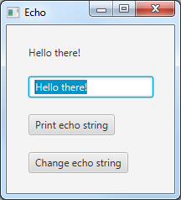
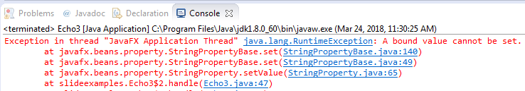
Echo3
GridPane setScreen() {
GridPane grid = new GridPane();
StringProperty echoString = new SimpleStringProperty("Hello there!");
Label echoLabel = new Label(echoString.getValue());
TextField soundTextField = new TextField();
soundTextField.setText(echoString.getValue());
Button printButton = new Button("Print echo string");
printButton.setOnAction(new EventHandler<ActionEvent> () {
@Override
public void handle(ActionEvent event) {
System.out.println(echoString.getValue());
}
});
Button changeButton = new Button("Change echo string");
changeButton.setOnAction(new EventHandler<ActionEvent> () {
@Override
public void handle(ActionEvent event) {
echoString.setValue("Good Bye!");
System.out.println(echoString.getValue());
}
});
echoLabel.textProperty()
.bind(soundTextField.textProperty());
echoString
.bind(soundTextField.textProperty());
//set components in the grid
grid.add(echoLabel, 0, 0);
grid.add(soundTextField, 0, 1);
grid.add(printButton, 0, 2);
grid.add(changeButton, 0, 3);
grid.setAlignment(Pos.CENTER);
grid.setVgap(20);
return grid;
}}

Slide 8
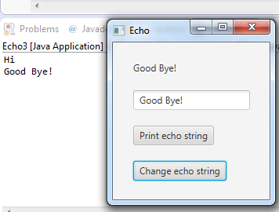
Echo3
GridPane setScreen() {
GridPane grid = new GridPane();
StringProperty echoString = new SimpleStringProperty("Hello there!");
Label echoLabel = new Label(echoString.getValue());
TextField soundTextField = new TextField();
soundTextField.setText(echoString.getValue());
Button printButton = new Button("Print echo string");
printButton.setOnAction(new EventHandler<ActionEvent> () {
@Override
public void handle(ActionEvent event) {
System.out.println(echoString.getValue());
}
});
Button changeButton = new Button("Change echo string");
changeButton.setOnAction(new EventHandler<ActionEvent> () {
@Override
public void handle(ActionEvent event) {
echoString.setValue("Good Bye!");
System.out.println(echoString.getValue());
}
});
echoLabel.textProperty()
.bind(soundTextField.textProperty());
echoString
.bindBidirectional(soundTextField.textProperty());
//set components in the grid
grid.add(echoLabel, 0, 0);
grid.add(soundTextField, 0, 1);
grid.add(printButton, 0, 2);
grid.add(changeButton, 0, 3);
grid.setAlignment(Pos.CENTER);
grid.setVgap(20);
return grid;
}}
Note that change in echo string also changed soundTextField which in turn changed echoLabel

Slide 9
Summary
JavaFX Components function as Java beans
You can ‘bind’ components together so that change in one changes the other
To bind any internal data variables with JavaFX components, define them as one of the property data-types so that they can be bound with JavaFX components

